Slide 1
FashioNXT: Event360

Slide 2


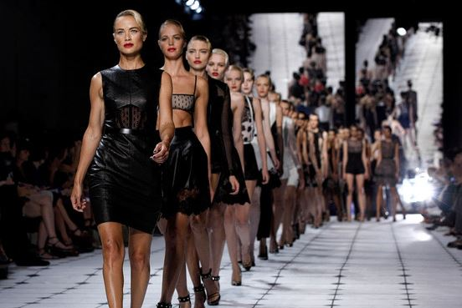
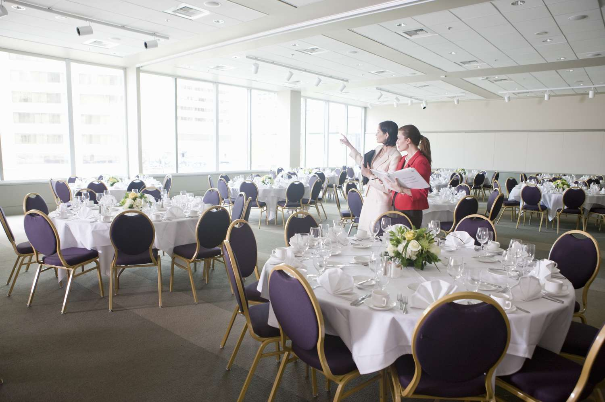
Sponsor and Target Users
Sponsor is the company FashioNXT run by Mr. Tito Chowdhury
Event management company focused on fashion industry
Target users are Mr. Chowdhury initially
Plans to expand to broader use
Mr. Tito Chowdhury

Slide 3



Project Flow
Event360: Collection of apps developed for the company FashioNXT
Made up of:
Event360 CRM
Central login and admin management tool
PlaNXT
Venue floor planning tool
CastNXT
Talent management tool
EventNXT
Event and RSVP management tool

Slide 4
EventNXT: Event360

Slide 5
About EventNXT
EventNXT is an app aimed at improving guest list management for live events.
Goals:
Provide event organizers with real-time ticket data, enabling efficient management of seating capacities and maximizing ticket sales.
Key features:
Central login using Event360 (CRM Integration), Event creation and management, box office data uploads, guest management and email communication.

Slide 6
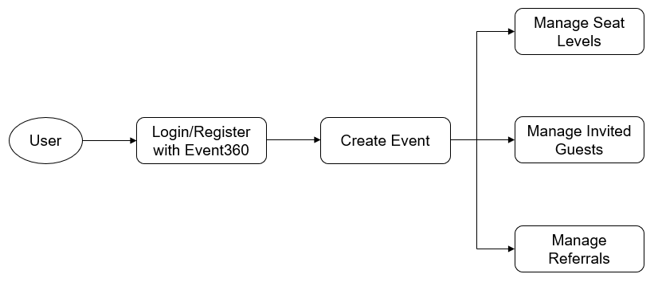
Application Flow

Slide 7
Improvements
Successful sign out feature
Sign out feature tests
Upload Manage Guests
Upload manage guest tests
Fix guest destroy button when upload manage guest
UI for manage guest
Sending out RSVPs
Test for sending RSVPs
Update committed seats
Fix last semester’s code coverage
Parsed box office data
Referral email to guest
Update Seating Summary
Track referred person information
Reward calculation when we have the corresponding referral tuples
Parsing ticket buyer information from .xlsx file
Referral email to guest’s friend
Fix heroku deployment
Test for sending email to guest

Slide 8
Difficulties
Pushing a container to heroku and having the app not crash
Being a legacy project, there was an old_EventNXT_app and new_EventNXT_app. It was a difficult to use old_app code for new_app since it had a different code base. (Javascript vs Ruby on Rails)
Lots of broken features since last semester’s team rushed the process of transferring features through varying code bases

Slide 9
Future Development
Better UI
Importing guest from third party
Reward for referrals
Better code coverage

Slide 10
PlaNXT: Event 360

Slide 11
Introduction
What is PlaNXT:
A floor planning application that simplifies the planning process
Comprehensive pipeline that guides users from the initial creation of an event to adding steps and design layout for the venue
Novel time-lapse function for visualizing the event’s progression and their corresponding layouts in 3D
End Users:
Event Organizers who seek to meticulously plan and visualize every aspect of their events
Notes:
PlaNXT is an innovative Venue Floor Planning application thats designed to enhance the event planning process, offering a streamlined and user-friendly experience.
It features a comprehensive pipeline that guides users from the initial creation of an event through various stages, including detailed layout design for the venue.
A unique time-lapse feature allows planners to visualize the event's progression and corresponding layouts in a dynamic 3D format, providing a real-time perspective of spatial arrangements at different stages.
This is a legacy project; however due to the poorly design database, unorganized app structure, and various functionality bugs, we decided to refactor the whole app to better suit our development of integrating 3D visualization with the 2D planning page

Slide 12
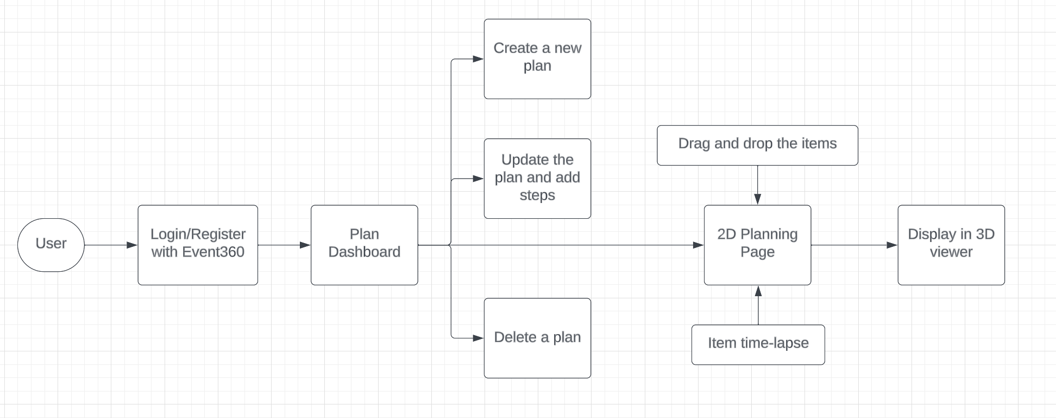
Application Flow

Slide 13
Key Improvements
Sign out out all apps from PlaNXT app
Readable Floorplan CSV File Download
Save Floorplan as CSV File
Improve tests and coverage
Able to upload Floorplan CSV File but won’t populate the floorplan
UI improvements

Slide 14
Difficulties
First App we worked on so getting caught up to speed with how everything works
Being a legacy project
Understanding how the 2D visualization works
Understanding how the 3D visualization works
Many bugs that were found while manually testing the app
Notes:
Modify on the 3D viewer repository is very difficult as it is a third party repository that contains more than 40 thousands lines of code that involved three.js and rendering

Slide 15
Future Development
Better UI
Improve tests
Add time adjustments to when an item is dependent on another item. For example, if I want to set up a table at 1 pm and then a chair to be added to that table at 1:05 pm but now the user wants to set up table at 1:30 pm, have the app automatically adjust the chair to be added at 1:35 pm. Do this with break times as well.
Add the cursor slide that was implemented in the 2D floorplan to the 3D floorplan. This will require more than one person and a few days to implement.

Slide 16
CastNXT: Event 360

Slide 17
Introduction
What is CastNXT:
Simplify and Automate entire event management flow
Streamlining the process of selecting/shortlisting candidates
Assigning Talent to a client and Arrange them based on preference
Producer/Admin negotiating with clients about a talent
Finalizing talent selection for an event.
Our End Users:
FashioNXT – Admins or Producers: To Manage the App.
Event Participants and Models – Talents: Search and Register for Events.
Designers and Clients: Showcase events using assigned Talents.

Slide 18
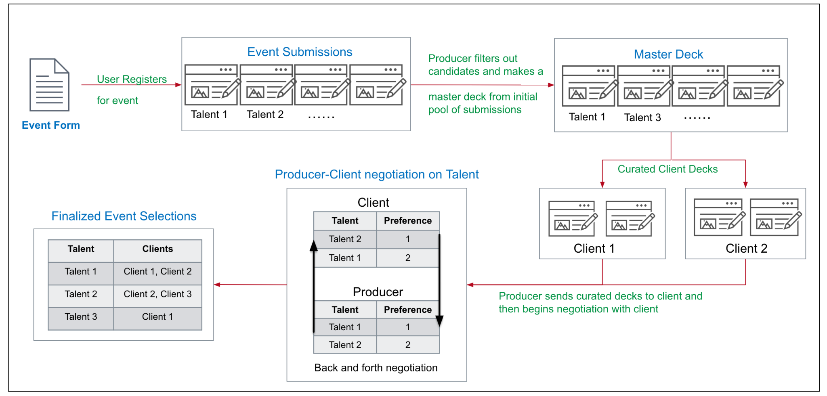
Application Flow
Tech Stack: Ruby, ReactJS(UI), Mongo(DB), JEST(testing)

Slide 19
Key Improvements
Improved last semesters React tests
On Click Coloring Effect of Client Event Summary
Coloring Effect of Client Event Summary Jest Testing
Sorting Mechanism of Client Event Summary
Sorting Mechanism of Client Event Summary testing
Update Email feature
Removed 'Guests Committed' from Events page
Remove 'Guests Committed' from New Guests Page
Add a 'Section' column to Seats
Add a 'Section' column to Guests
Debugged App Deployment
Sign Out Feature for CastNXT to sign out of all three apps
Write a Cross-Origin Resource Sharing Method
Implement Email Notification when Update Decks is Pressed
‘Manage Seating Levels’ was updated to display the Sections Column
Seating Summary was updated to display the Sections Column
Create a new section in “Add New Seats”
Display the new seating summary based on categories and section
Debugged App Deployment in CastNXT
Add “image” attribute to form
‘Manage Seating Levels’ was updated to display the Sections Column
Seating Summary was updated to display the Sections Column
Create a new section in “Add New Seats”

Slide 20
Difficulties
Being legacy code from a different part of last semesters group had different code structure
Mongo database was confusing and hard to get to work
Can only do development on windows using WSL. Will not work on Mac
This app runs very slow so made manually testing difficult
Fixing last semesters react tests slowed us down
Pushing a container to heroku and having the app not crash

Slide 21
Future Development
Debug email notification when button update decks is pressed. It will not send the email even though the server side says it did.
Improve and write tests that we missed due to time constraints
Improve the latency of the app
This app is pretty much ready for production

Slide 22
The End!

